Slide 1
UWCCSC Math Circle
Will’s Linear Algebra Project
Session 1 – 11.9.25

Slide 2
Table of contents
01
02
03
04
Vector Spaces
Inner Products
Proofs about whether a set is a vector subspace
Understanding the geometric inequalities in vector spaces and their algebraic form
Operators and Adjoints
Proof
Mostly matrices. Quickly covering the complex field. Things about the orthonormal base.
Prove the C* identity and some weighted (weight on the real part and imaginary part) transformations

Slide 3





Slide 4
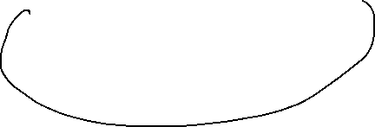

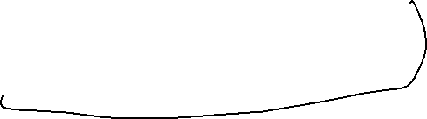







Slide 5
How?
My content will be more intuitive instead of proof-based

Slide 6
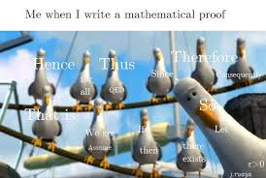


Slide 7
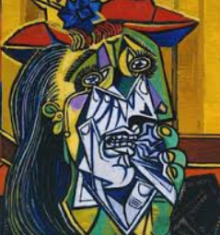








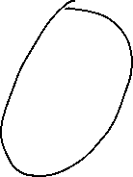

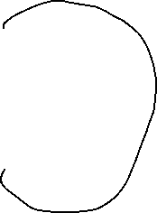

Slide 8
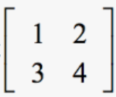
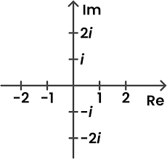
Table of contents
01
02
03
04
Vector Spaces
Inner Products
A mashup of vectors and where can they reach
How multiplication of vectors can let you measure stuff
Operators and Adjoints
Proof
somehow in
Some real bad-ass stuff with weighted operators
Backup session
05
More or less stuff

Slide 9
01
What is a vector?

Slide 10
Vectors
A vector has a magnitude and a direction.
Vector isn’t defined by what it is, but rather what you can do with it.

Slide 11
What makes a vector space?

Slide 12
What makes a vector space?

Slide 13
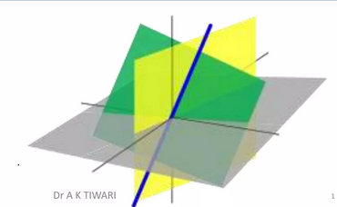
What does a vector space look like?
Visualization of

Slide 14
Examples of vector spaces

Slide 15
Examples of vector spaces

Slide 16
Examples of vector spaces

Slide 17
What operations did we just make?

Slide 18
Building blocks of vector spaces
Span: The set of all possible vectors you can build from a set.
Linear independence: A set of vectors is independent if no vector can be built from others.
Base: the basic set in vector space that has the span of the space and linear independence.
Dimension: the number of vectors in its basis.

Slide 19
The subspace test
Containing zero, being closed under addition and scalar multiplication

Slide 20
Let’s prove it!

Slide 21
Let’s prove it!

Slide 22
Recap of what we just did
Defined
vector space
10 axioms
Prove
subsets
Span, linear independence, basis, and dimension.

Slide 23
What are we missing?
Geometry
Angle, length between vectors
Concept of being perpendicular

Slide 24
See you next time!

